Slide 1


RNSIT Placement Cell

Slide 2

Good Everyone
I am Anit Kumar
(1RN14MCA08)
I am here because I love to give presentations.
You can find me at:
anikumarsingh99@gmail.com

Slide 3

Let’s start with the contents first

Slide 4

Contents
PREFACE
INTRODUCTION
EXISTING AND PROPOSED SYSTEM
HARDWARE & SOFTWARE REQUIREMENTS
SYSTEM REQUIREMENTS
FUNCTIONAL & NON-FUNCTOINAL REQUIREMENTS
SYSTEM DESIGN
TESTING
CONCLUSION
FUTURE ENHANCEMENTS
BIBLIOGRAPHY

Slide 5
Preface
‘RNSIT Placement Cell’ system is designed and developed to provide a comprehensive platform for the organization to hire prospective candidates with fresh ideas and rich technical skills, for the students to register, view and apply for the suitable jobs as specified by the organization through various facilities such as online test

Slide 6
Introduction

Slide 7

One of the greatest responsibilities of the institutions is that, not only providing quality education will suffice but also providing a better platform for the students to get into a good organization to spread their wings in the world of competition.
Thus the ‘RNSIT Placement Cell’ comes into frame to help the institutions provide various services not only to the students but also to the organizations and establish a communication platform between them.

Slide 8

Existing System
Provides a partial solution to the required services.
Manual intervention with extended cost and time.
Multiple number of mutually exclusive student and company system.
Tedious task of managing different systems and redundant wastage of resources to the institutions.

Slide 9

Proposed System

Slide 10

Aims at integrating different systems into co-dependent single system with smooth and effective interface.
Contains 3 Modules :
Admin
Student
Company

Slide 11

Hardware Requirements
Component | Minimum | Recommended
Processor | 1.7 gigahertz (GHz) | Dual processors that are each 3 GHz or faster
RAM | 1 gigabyte (GB) | 2 GB
Display | 1024 × 768 | 1024 × 768 or higher resolution monitor
Memory | 80 GB | 500 GB

Slide 12
Software Requirements

Slide 13

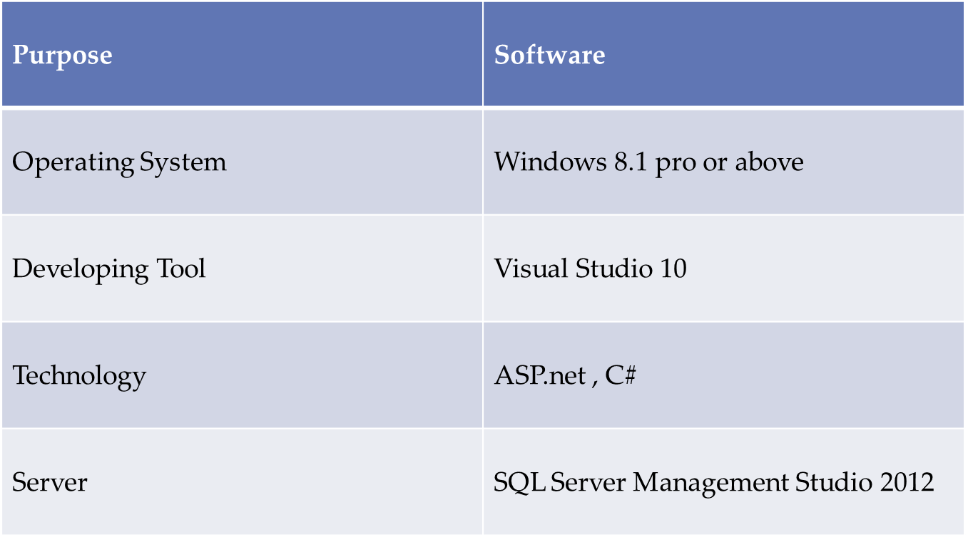

Slide 14
Functional Requirements
Admin Module | Student Module | Company Module
View Student Profile | Register | Register
Update Student Profile | View Job Listings | Upload Criteria
View Company Profile | Specify preferences | Edit Criteria
Initiate Process | Take test | Conduct Test

Slide 15
Non-Functional Requirements
Usability- Easy to deploy and easy to use with minimal understanding of the system.
Reliability - Dedicated server to host the website which prevents the loss of data.
Availability - The system will be made available to the users 24*7.
Security - The website provides a secured interface for all information and communication mechanism.

Slide 16

System Design
Entity Relationship Diagram.
Company Module Use Case Diagram
Company Module Activity Diagram
.
Student Module Use Case Diagram
Student Module Activity Diagram

Slide 17
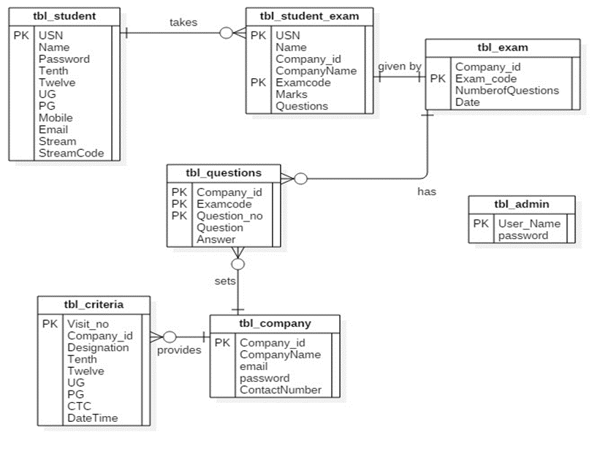
Entity Relationship Diagram

Slide 18
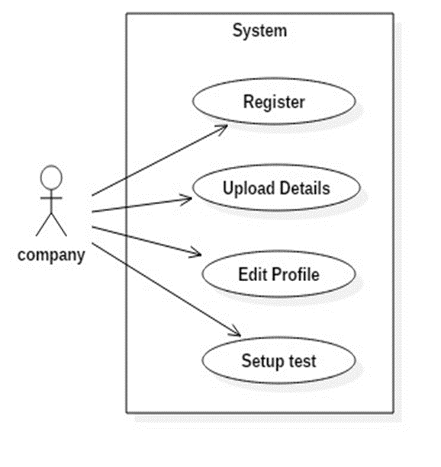
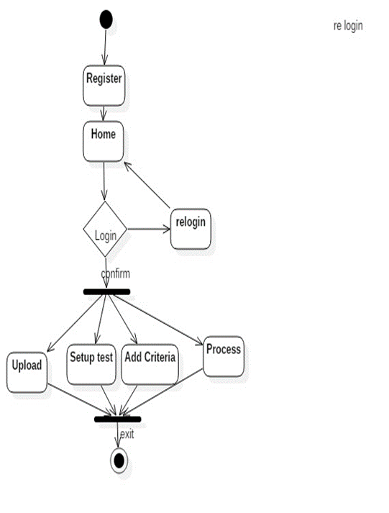
Company Module Use Case Diagram
Company Module Activity Diagram

Slide 19
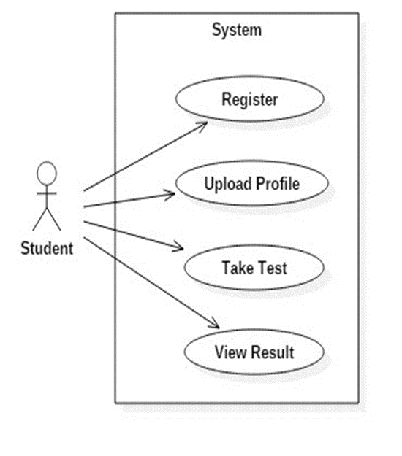
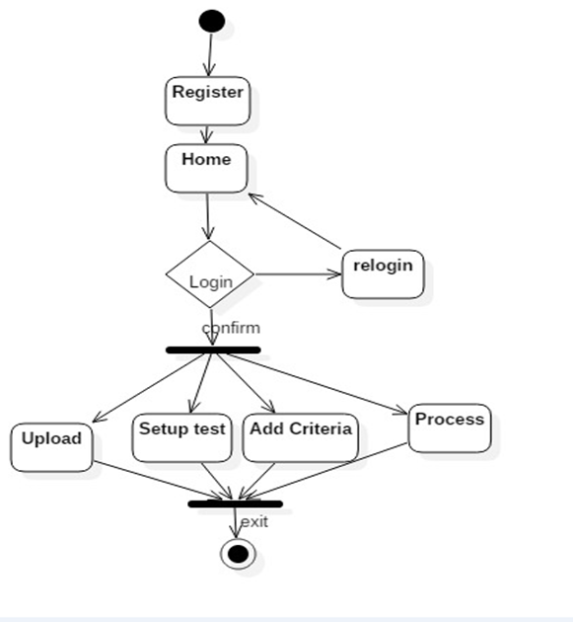
Student Module Use Case Diagram
Student Module Activity Diagram

Slide 20

Testing
The testing method used in this application is predominantly Black-Box testing where the most useful requirements and functions are checked for their correctness.
Some of the requirements which are checked are
User registration
Conduct test
Update profile
Some of the tested functionalities are
Redirection to test page
Numeric validations
Character Validations

Slide 21


REFERENCES
C#2010 for programmers, 4th edition, Pearson education, By - Paul Deitel and Harvey Deitel.
Pro c# 5.0 and .NET 4.5 Framework , 6th edition ,Wiely-Appres By - Andrew Trolsen.
WEBSITES
www.stackoverflow.com
http://www.tutorialspoint.com/asp.net/
http://zetcode.com/db/mysqlcsharptutorial/

Slide 22
Conclusion
This website provides a radical new approach in the field of education by providing a convenient and easily understandable interface for the hiring process.
As the name ‘Placement Cell’ suggests students will be guided through the entire process to select the best matching company portfolio and to kick start their professional journey in a well-established manner.

Slide 23

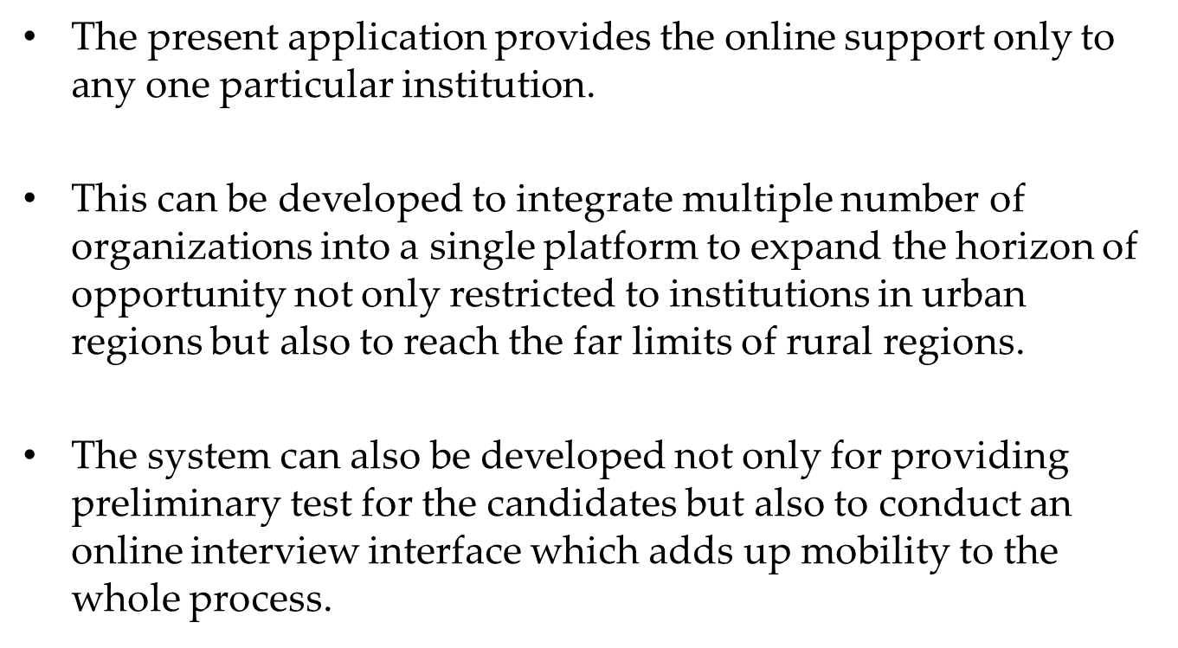
Future Enhancements

Slide 24
Thank You
Any questions?
You can find me at:
anikumarsingh99@gmail.com

